Slide 1

Binary Operations
Presented By:
Elizer Ponio Jr. Department of Computer Science
College of Computing and Information Technologies

Slide 2
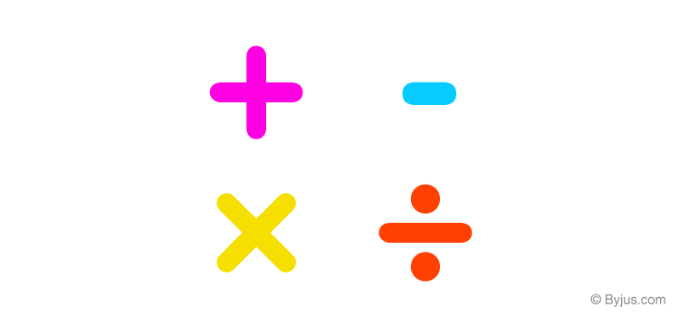
Binary Operations
You can add, subtract, multiply, and divide binary numbers using various methods.
These operations are much easier than decimal number arithmetic operations because the binary system has only two digits: 0 and 1.

Slide 3
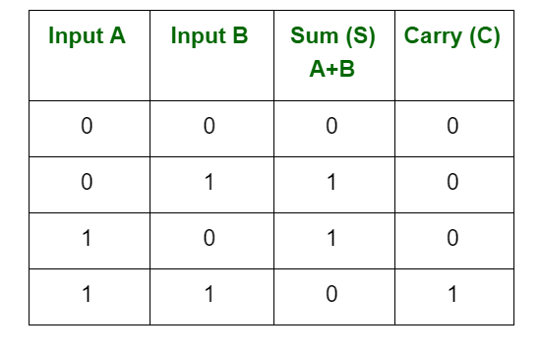
Binary Addition

Slide 4
Binary Addition
Carry 1
1 0 1
(+) 1 0 1
-----------
Step 1: First consider the one’s place, and add the one’s place which will give the result 0 carry 1
Step 2: Now add ten’s place.
Step 3: Now add the hundred’s place. Leave the value 0 in the hundred’s place and the carry 1 to the thousand’s place.
1
0
1
0

Slide 5
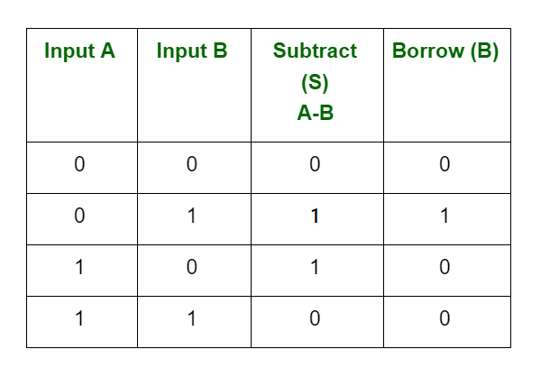
Binary Subtraction

Slide 6
Binary Subtraction
Borrow 1
Borrow 1
0
1
1
0 0
(-) 1 0 1
-----------
0
Step 1: First consider the one’s column, and subtract the one’s column,( 0 – 1 ) and it gives the result 1 as per the condition of binary subtraction with a borrow of 1 from the 10’s place.
Step 2: After borrowing 1 from the ten’s column, the value 1 in the 10’s column is changed into the value 0
Step 3: So, subtract the value in the ten’s place, ( 0 – 0 ) = 0.
0
1
0
1
Step 4: Now subtract the values in 100’s place. Borrow 1 from the 1000’s place ( 0 – 1 )

Slide 7
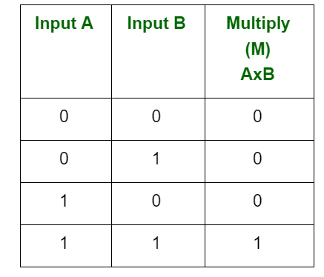
Binary Multiplication

Slide 8

Binary Multiplication
1 0 1 0
x 0 1 1 0
-----------
0 0 0 0
1 0 1 0
1 0 1 0
(+)
0 0 0 0
----------------
0 1 1 1 1 0 0

Slide 9
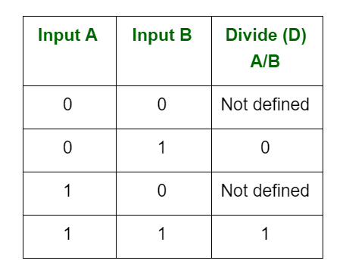
Binary Division

Slide 10

Binary Division
1
0
0
1
Step 1: Count the number of bits of the divisor. 101 has 3 bits.
1 0 1
1 0 1 1 0 1
-
1 0 1
---------------
Step 2: Get the last three bits of the dividend starting from the left.
0
1
0
1
-
1 0 1
Step 3: Perform division. 101 / 101 is 1.
---------------
Step 4: Multiply the quotient and the divisor. 101 x 1 is equal to 101
0
Step 5: Perform subtraction
Step 6: Each time we bring down a number, add a zero to the quotient.
Step 6: Repeat step 3, 4 and 5

